Slide 1
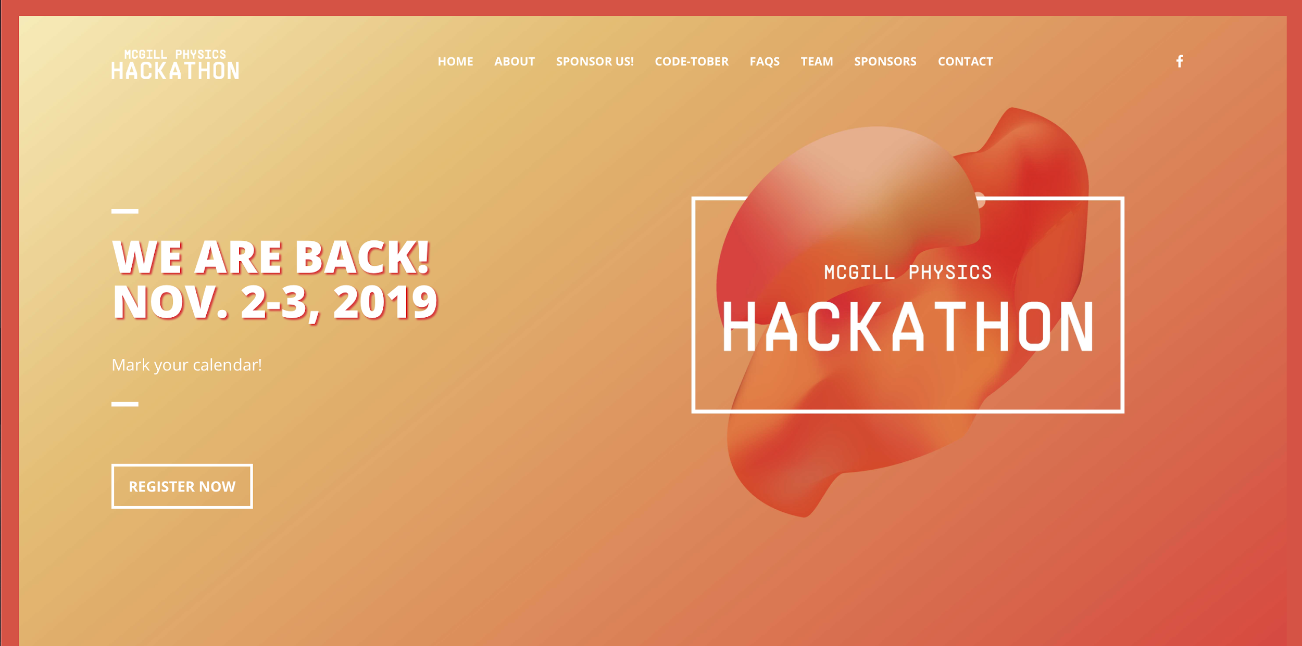

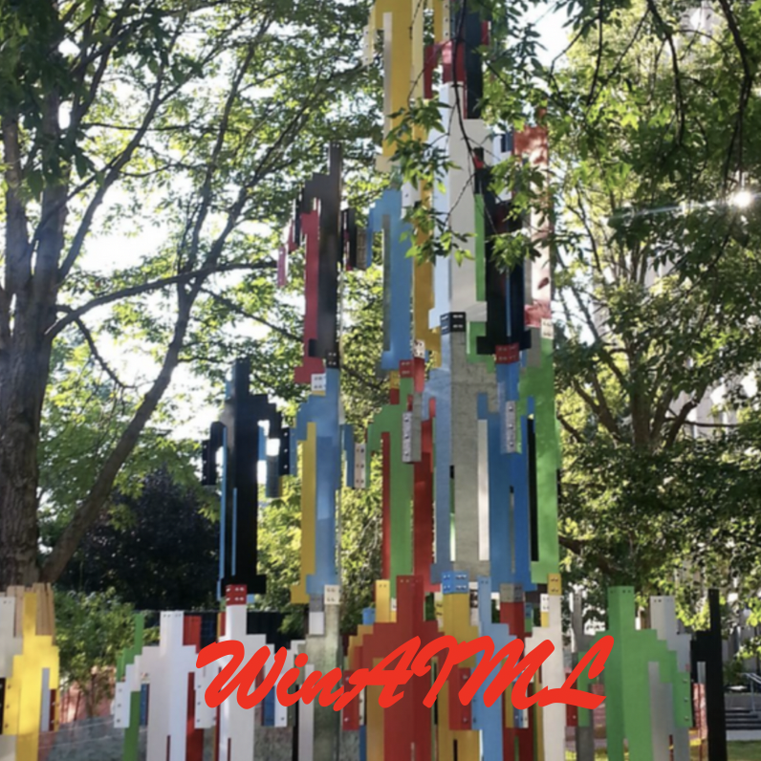
Nobel Prize ?
Anush, Swapnali,Jaspreet
Higgs Machine Learning Challenge

Slide 2
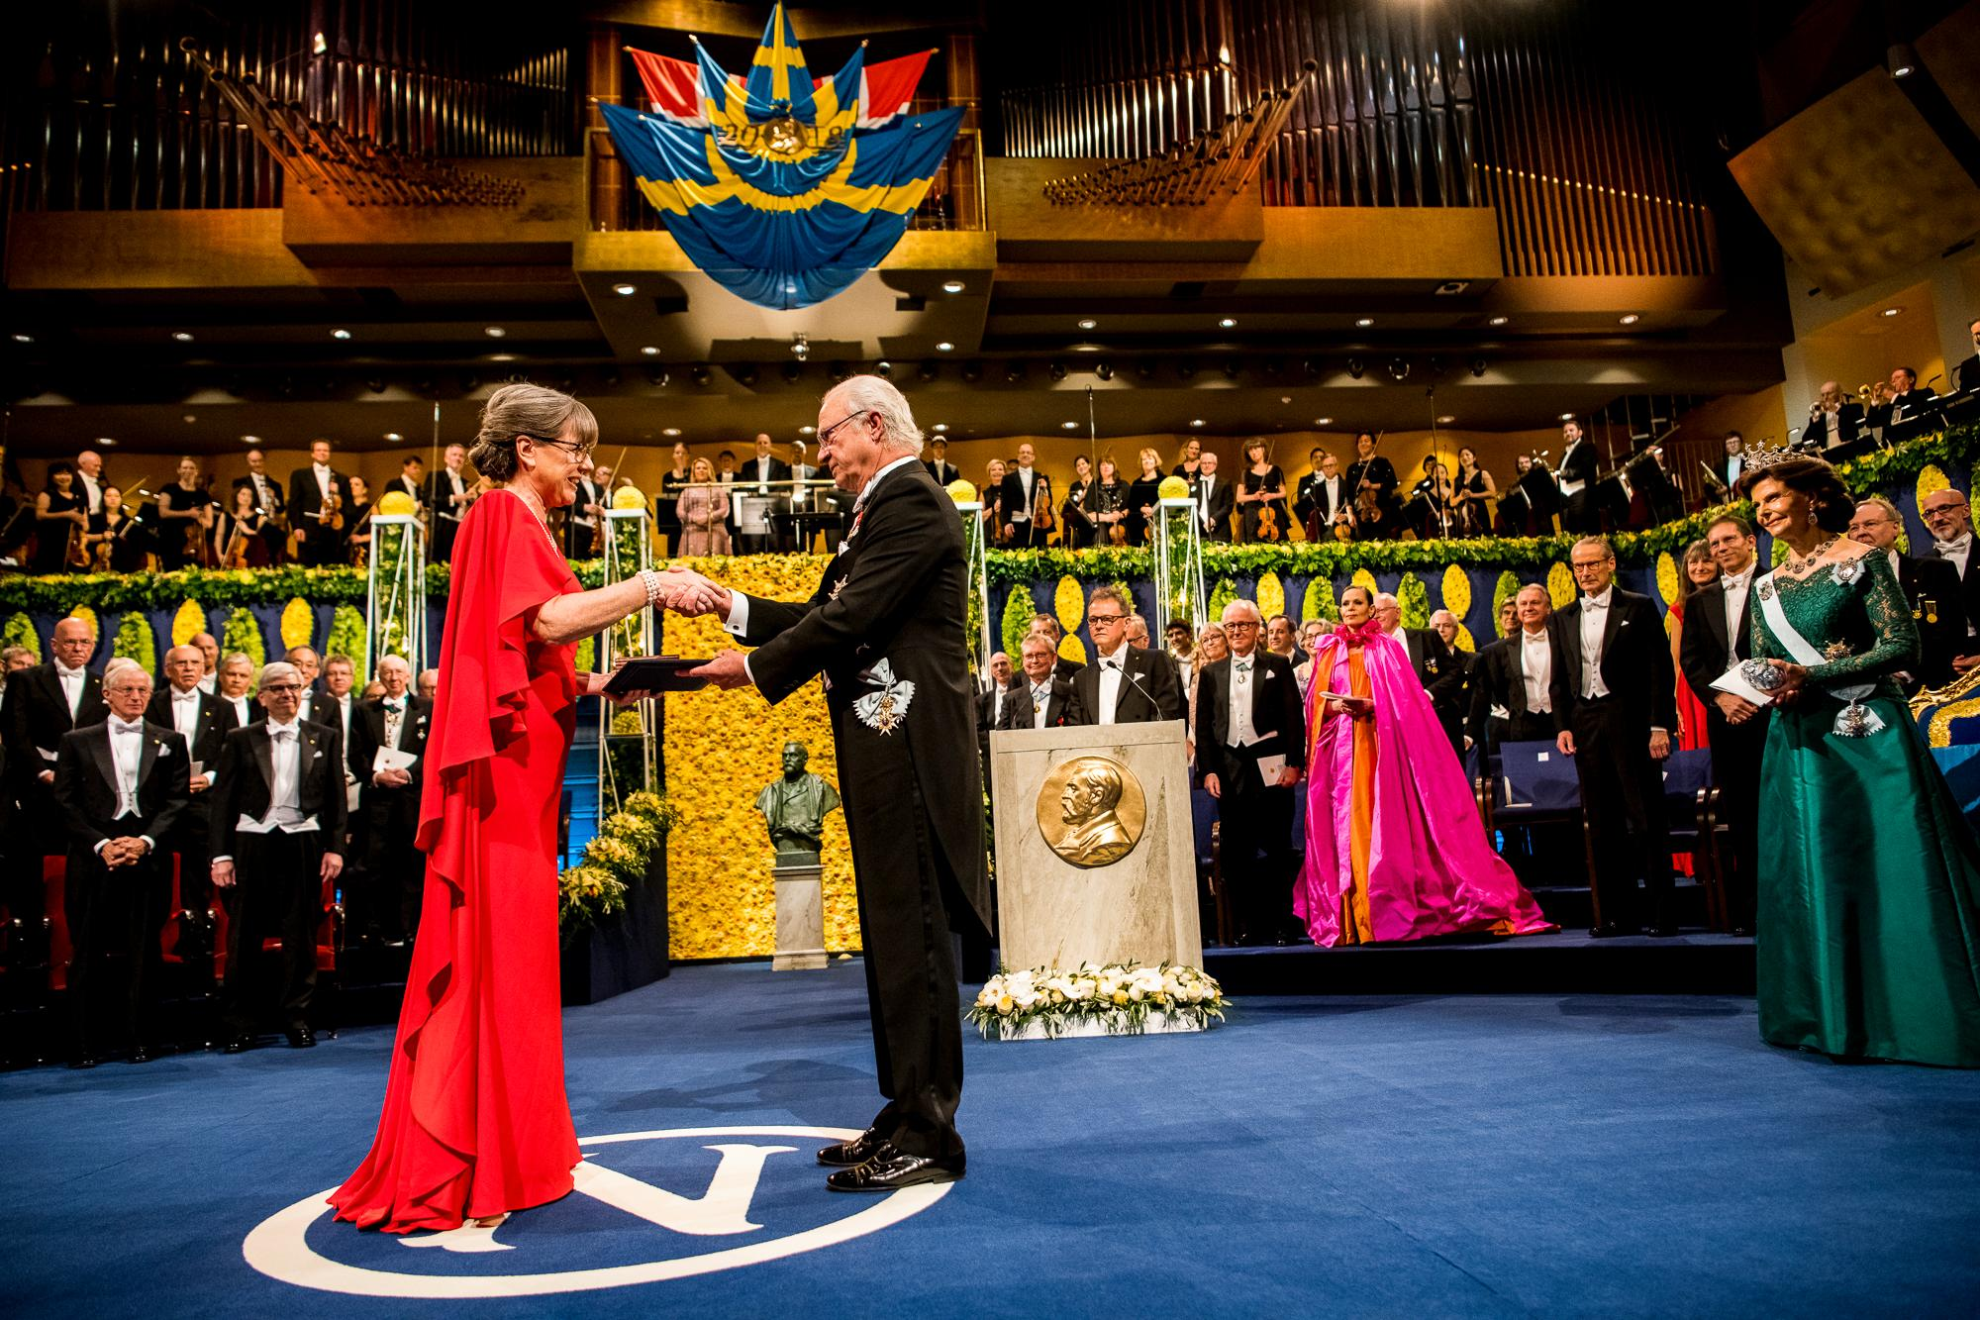
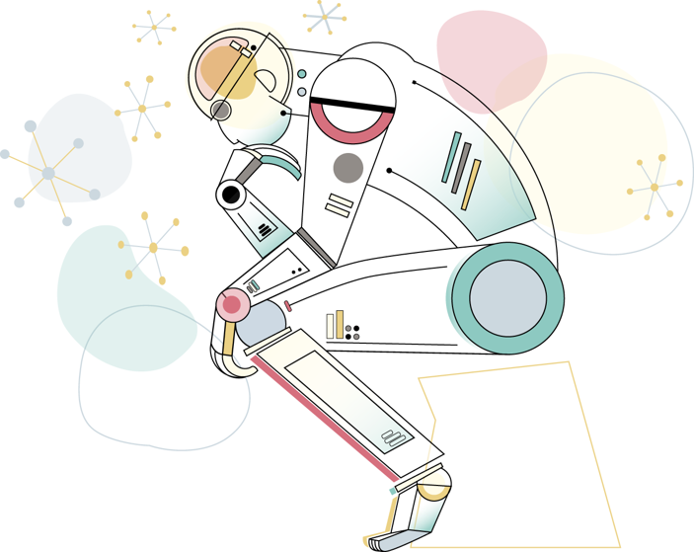
Can ML Assist
Scientists to Get
Nobel Prizes?

Slide 3
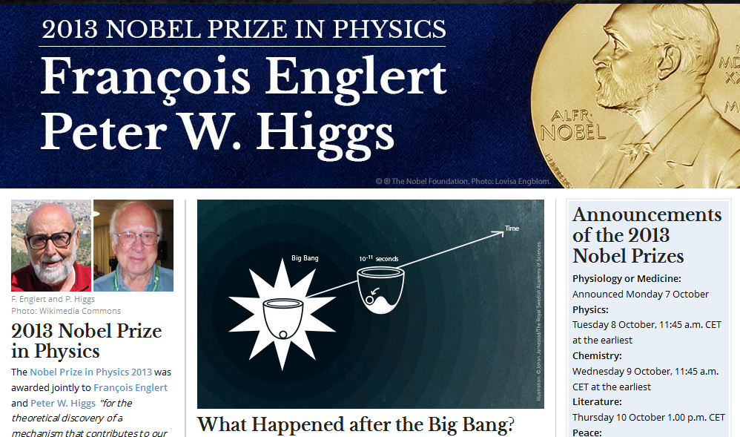

Slide 4
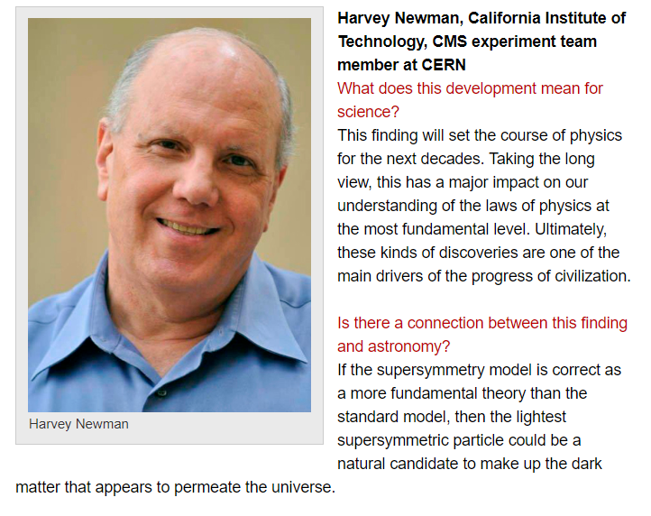
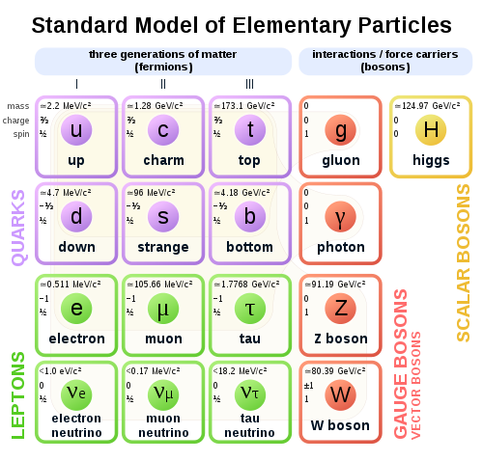
Astronomical significance

Slide 5
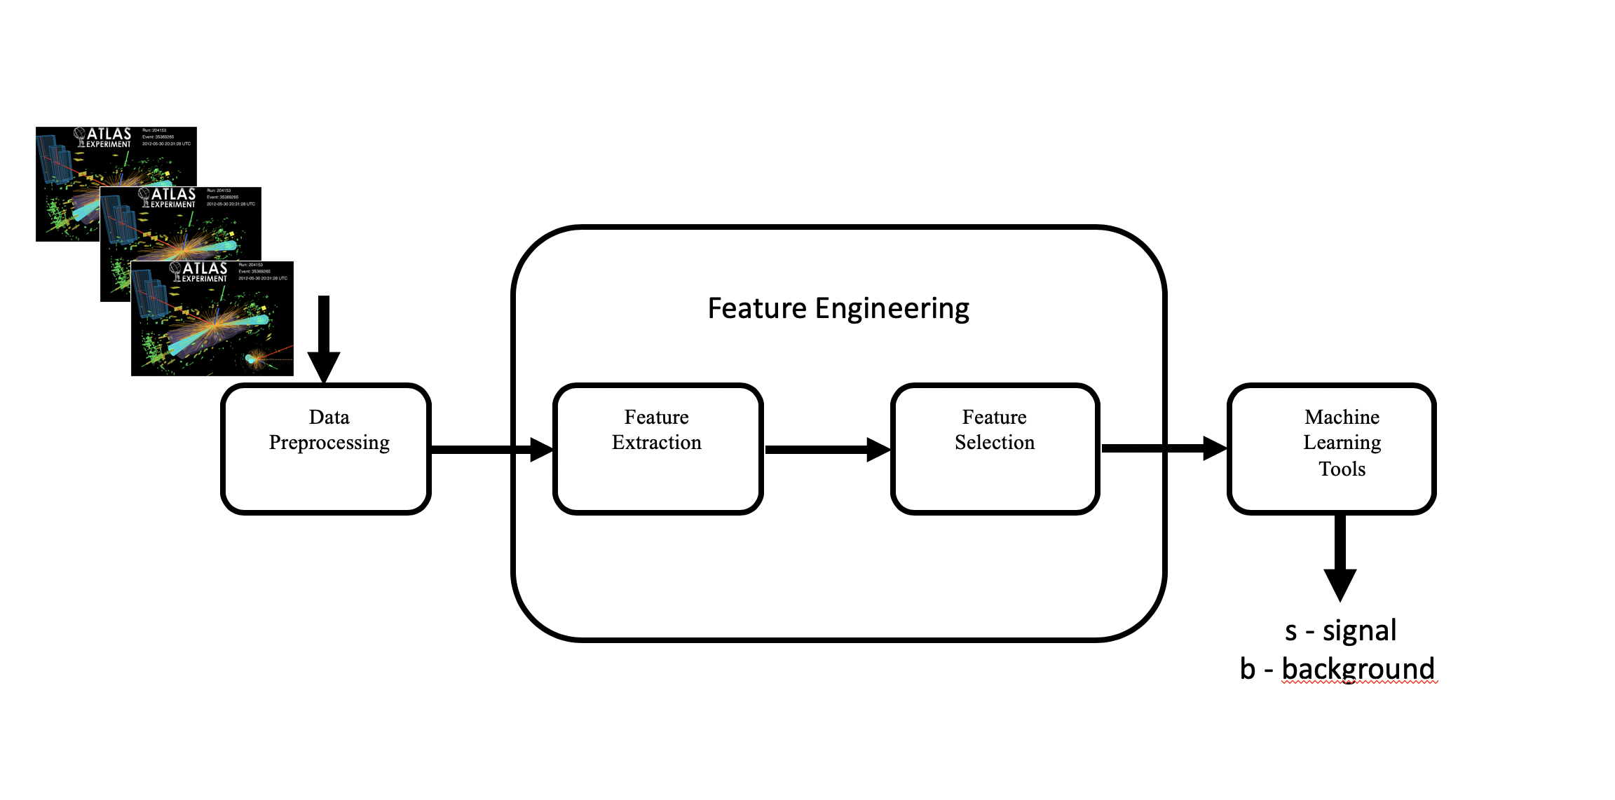
Methodology

Slide 6
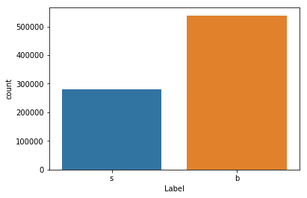
Dataset
Labels: s - signal, b - background
Features : 34
Events : 818238
s : 279560 (35%)
b : 538678 (65%)

Slide 7
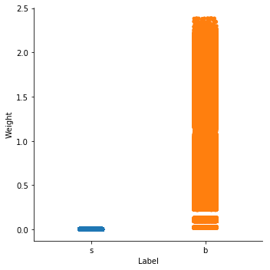
Dataset
Weights distribution across the labels

Slide 8
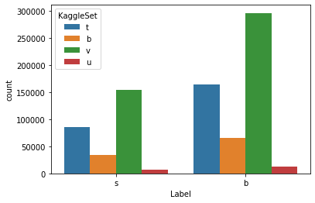
Dataset
Kaggle sets
t : training
b: public leaderboard
v : private leaderboard
u : unused

Slide 9
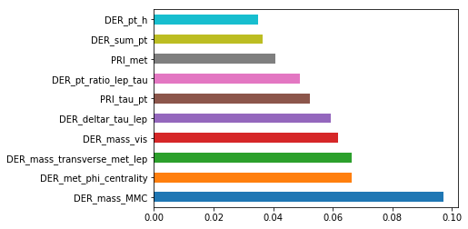
Feature Engineering

Slide 10
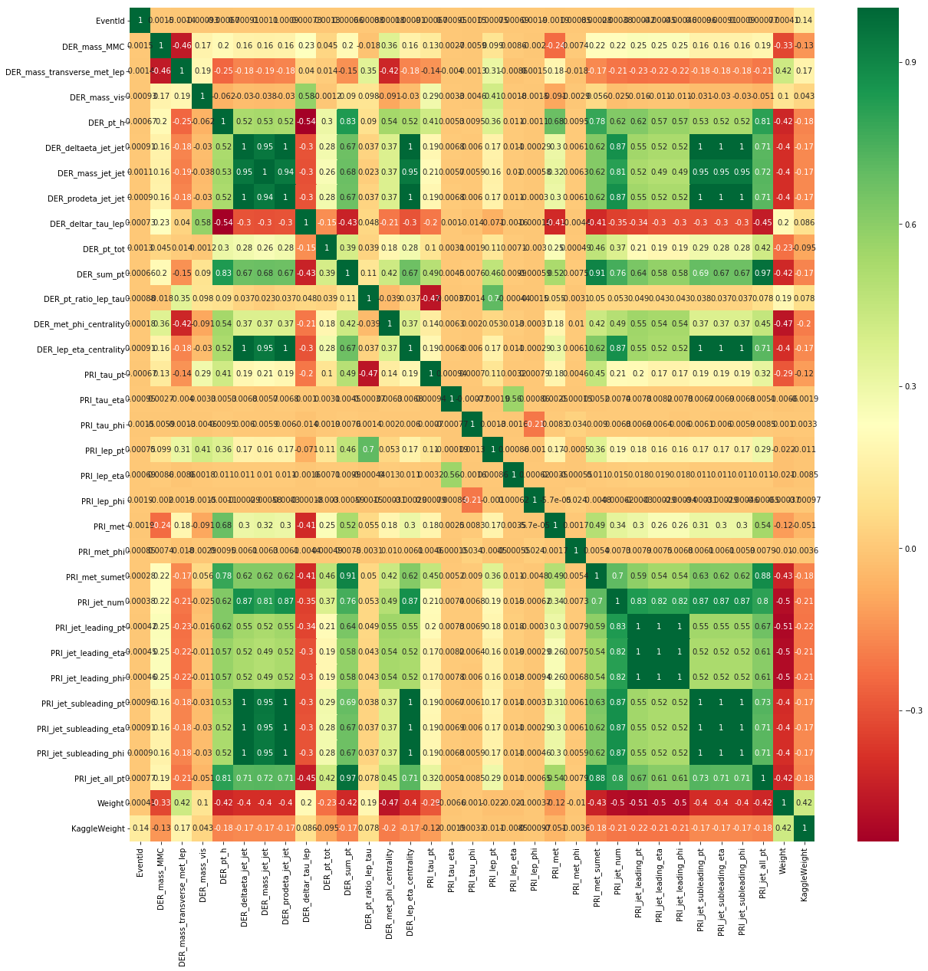
Feature Engineering

Slide 11
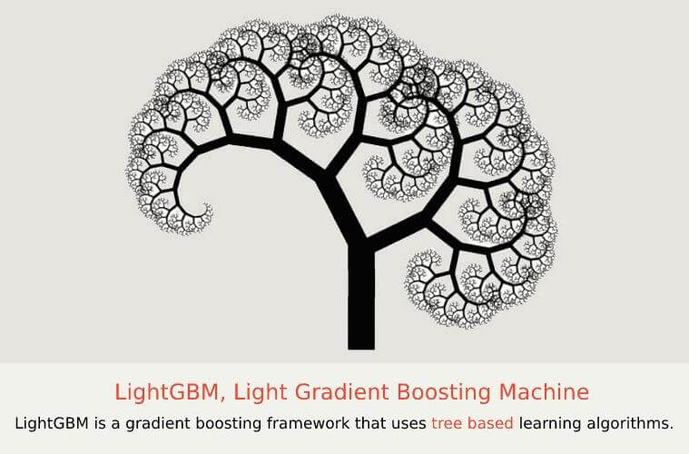
Machine Learning
# parameters for LightGBMClassifier
params = {
'objective' :'binary',
'learning_rate' : 0.1,
'num_leaves' : 76,
'feature_fraction': 0.64,
'bagging_fraction': 0.8,
'bagging_freq':1,
'boosting_type' : 'gbdt',
'metric': 'binary_logloss'
}

Slide 12
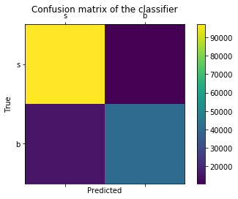
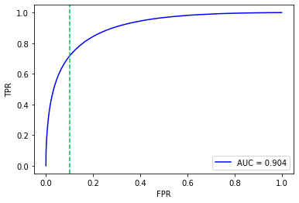
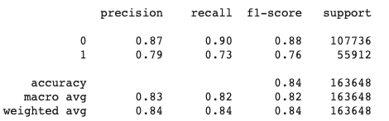
Results
Confusion matrix for the best classifier
Accuracy Metrics and ROC curve for the best model

Slide 13
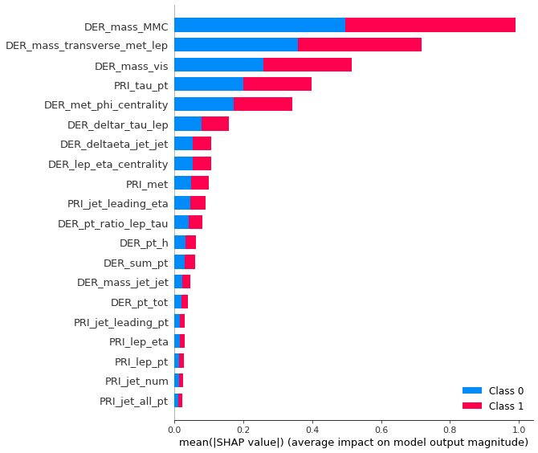
Feature Importance for the model

Slide 14
Other methods and accuracy
MLP Classifier - 65.8%
SMOTE - 82.5 %
Ensemble of LightGBM, RandomForest and SVM Classifier with kfold split:
83.4%

Slide 15
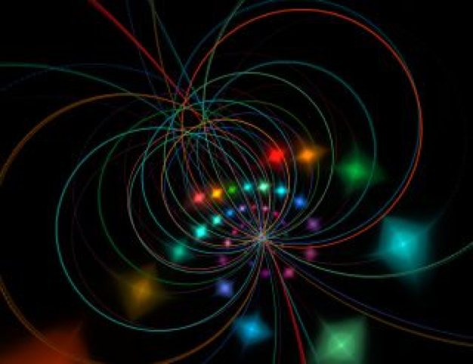
Future Direction
ML 4 String Theory

